Slide 1
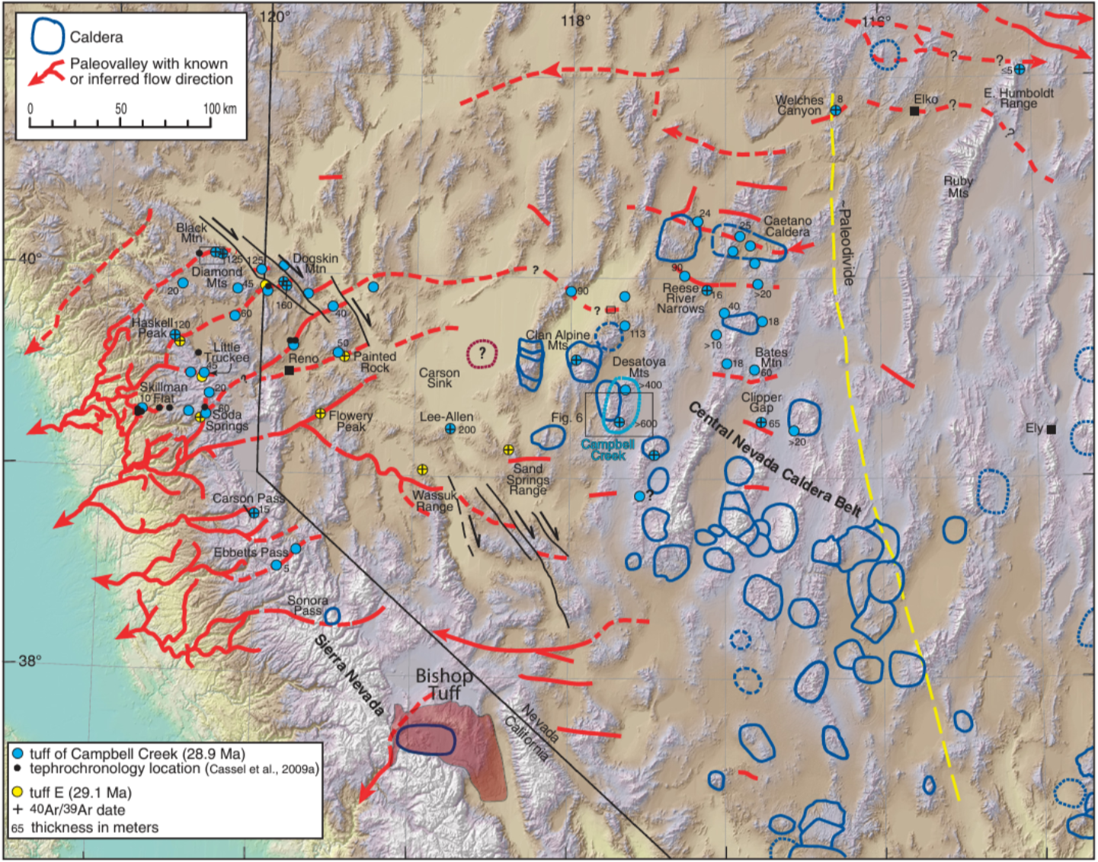
Eocene-Early Miocene paleotopography of the Sierra Nevada-Great Basin-Nevadaplano based on widespread ash-flow tuffs and paleovalleys
By Christopher D. Henry, Nicholas H. Hinz, James E. Faulds, Joseph P. Colgan, David A. John, Elwood R. Brooks, Elizabeth J. Cassel, Larry J. Garside, David A. Davis, and Steven B. Castor
Campbell Creek tuff (Tcc; 28.9 Ma) erupted from Campbell Creek Caldera in Desatoya Mtns
flowed ~200 km west through paleovalleys
Flowed ~215 km NE across major paleodivide and to Ruby Mountains
Flowed up to 100 km N and 60 km S, crossing several other paleodivides
Bishop Tuff (760 ka) only flowed ~50 km from source
Several other paleotuffs flowed far downvalley, but not so far E or N-S
How did Tcc spread so far?!
What does it tell us about timing of Sierra Nevada uplift and Nevada extension?
How low did the Nevadaplano gradient have to be in order to flow upvalley and cross the eastern paleodivide?

Slide 2
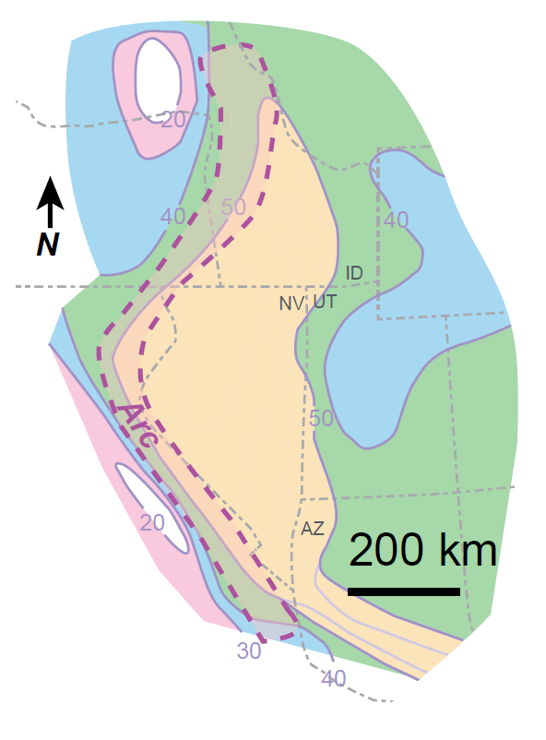
Nevadaplano
A made-up word (DeCelles, 2004)
A high plateau that covered parts of NV, ID, and UT in the late Mesozoic-mid Cenozoic
Great Basin was erosional highland in mid-Cenozoic – with a N-S paleodivide in eastern NV
Uplift dominantly result of Sevier (late Cretaceous) contraction in north, combined Sevier-Laramide (late Cretaceous-early Cenozoic) contraction in south
Rivers drained to west and east
Elevation of highland and Sierra Nevada in middle Cenozoic is debated
Distribution of Oligocene Tcc used to help constrain origin and extent of Nevadaplano
Say and Zuza, 2020

Slide 3
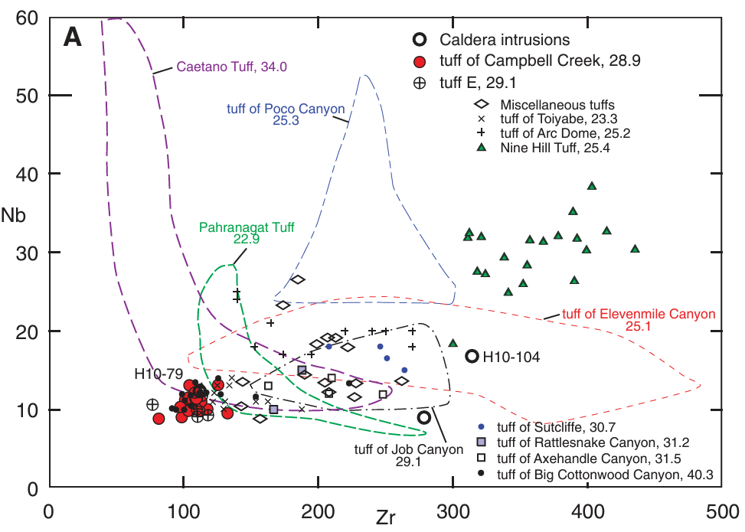
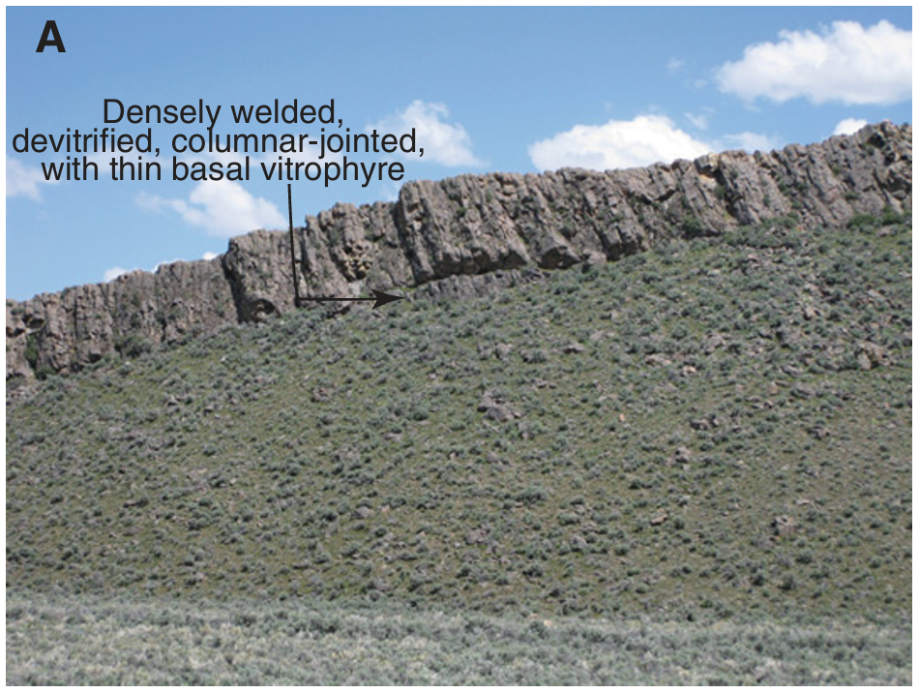
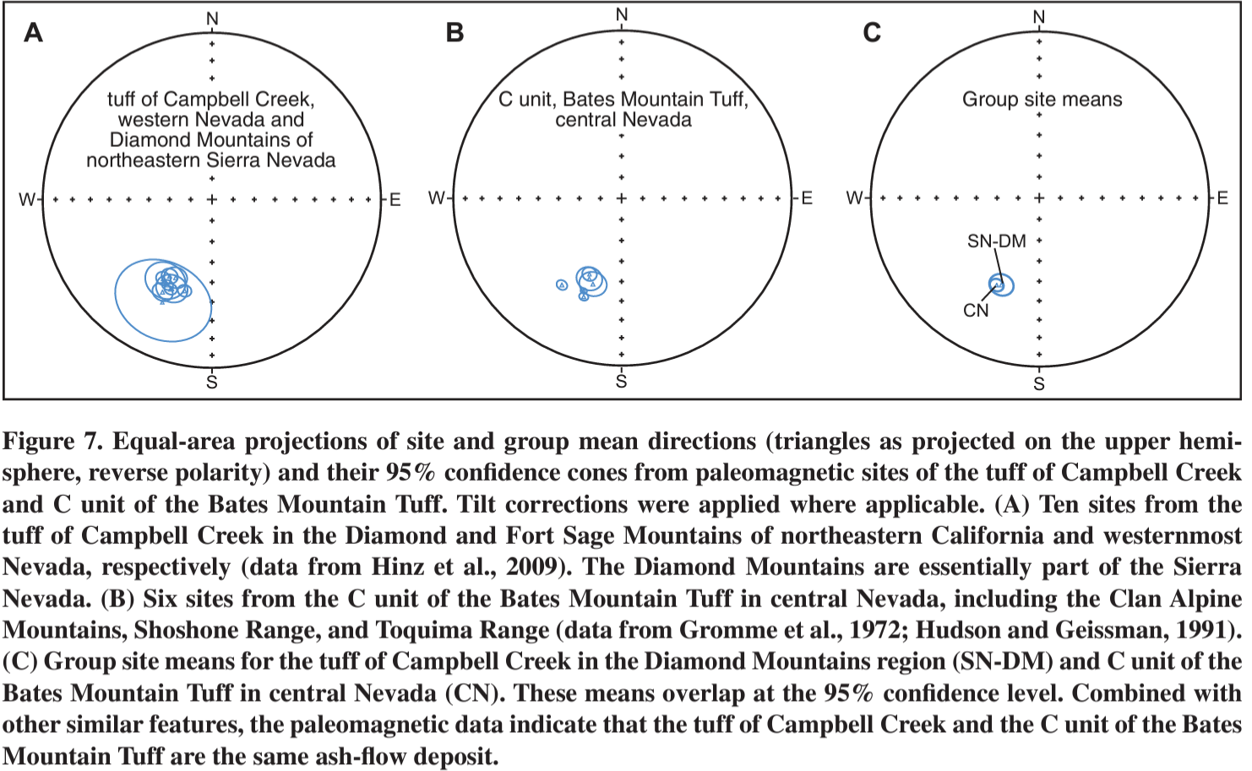
Tuff of Campbell Creek
28.9 Ma ash-flow tuff
Compositionally distinct – correlated across NV based on stratigraphic position, phenocryst assemblage, composition, ⁴⁰Ar/³⁹Ar age, and paleomagnetic direction
Compositionally homogeneous, high-SiO₂ rhyolite
Has low Zr and Nb concentrations - distinct from other tuffs in Great Basin
Overlapping tuffs (Toiyabe and Big Cottonwood Canyon) are different ages and petrographically/compositionally distinct
Distinctive characteristic remanent magnetization (CHRM)
Paleomag sites in Tcc in western Nevada have mean 206.1° declination and -43.0 ° inclination
Within error of sites in NE Nevada (203.6 ° and -44.1 °), suggesting they are same deposit
Does anyone else want to explain this?!
Tcc outcrop in Caetano caldera. Upper nonwelded tuff likely stripped by erosion.

Slide 4
Distribution
Distributed across at least 55,000 km² from Sierras to Ruby Mountains
Including ~100 km east of interpreted drainage divide (Henry, 2008)
Paleoflow was approx. 200 km west and 215 NE, corrected for extension
Extent to E (ie. upstream) and NNW (ie. perpendicular to paleovalleys) much greater than other tuffs in central Nevada caldera belt
Across 5 major paleovalleys
Nine hill tuff is the only comparable deposit
Potential causes (all theories, none investigated):
Low viscosity, high temp
High eruptive column
Low intervalley relief due to infill from past eruptions
530 km

Slide 5
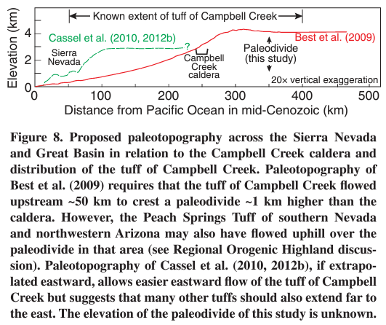
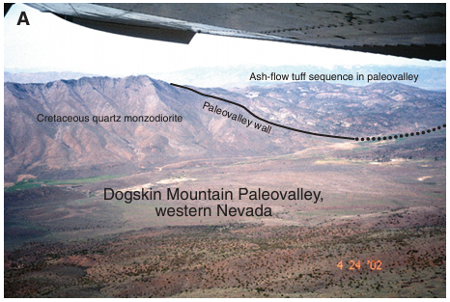
Implications for Structural Evolution
widespread deposits of 31.4 – 23.3 Ma tuffs crossing Basin and Range indicate faulting began post-23 Ma
Crossed Sierra Nevada → must have been topographically lower than Basin and Range
SN was a western ramp to Nevadaplano
Data from Quaternary ash-flow tuffs (Japan and NZ) suggest high gradient not necessary for tuffs to travel long distances
Minimum gradient of 2.5 m/km would require paleovalley bottoms to be at 500 m altitude (meaning interfluves would be ~1500m)
N

Slide 6
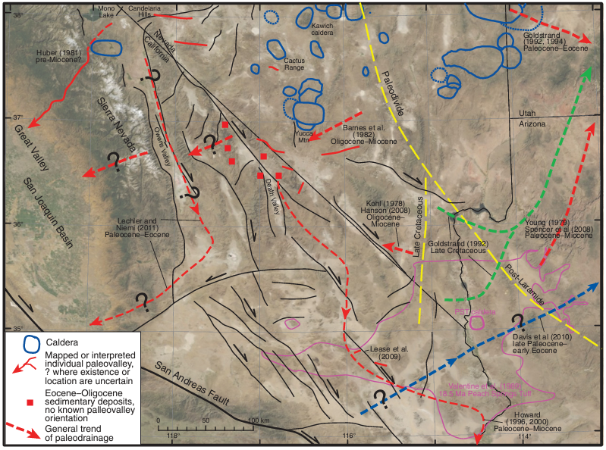
Paleovalleys Across the Southern Sierra Nevada
Mid-Cenozoic tuffs in Death Valley found in drainages in western Sierra Nevada → evidence for trans-Sierra paleodrainages in south
Two possible alternatives:
Southern Sierra Nevada was an “island” of higher elevation in early-middle Cenozoic; drainages went around
Would require more uplift of southern Sierras
Drainages crossed Sierra Nevada, but their deposits and geomorphic evidence have been removed by erosion

Slide 7
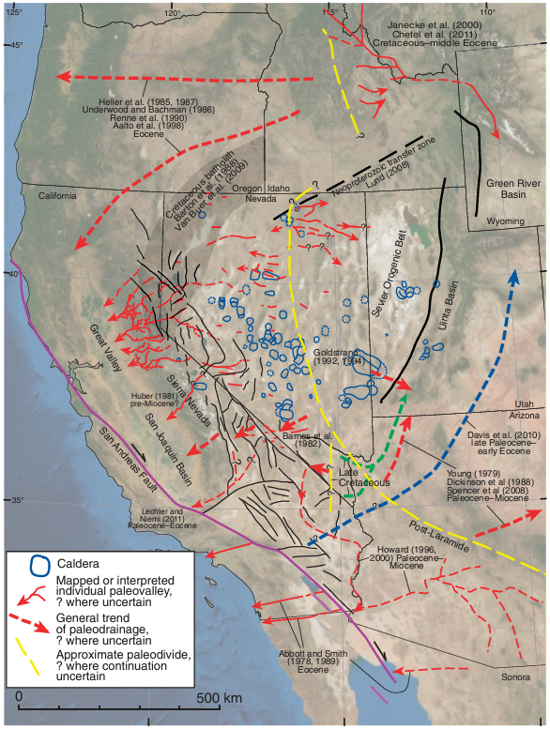
Regional Orogenic Highland
Combined paleodrainage interpretations indicate late Mesozoic to early Cenozoic erosional highland extended from central Idaho to northern Sonora
Paleodivides in NV and ID misaligned by “Neoproterozoic transfer zone” & greater post-Eocene extension in NV
Paleodivide shifted E and followed Laramide belt after Laramide uplift ca. 70 Ma or later
Most uplift of Nevadaplano happened in Eocene
They have no idea about absolute elevations

Slide 8
Key Takeaways
28.9 Ma Campbell Creek tuff erupted in north-central Nevada, spread ~200 km west and ~215 km northeast
Flowed across north-south paleodivide
Supports concept of Nevadaplano erosional highland (Sierra Nevada foothills to Ruby Mountains, and Idaho to Sonora)
High plateau developed in cretaceous
Nevadaplano elevation was ~1.5 km minimum
Paleodrainages crossed northern and central Sierra Nevada (maybe southern too?), flowed into Pacific
Sierras reached their present height in Late Miocene-Pliocene
Basin & Range extension dismembered the highland – post 23 Ma in western NV and post-29 Ma in northeastern NV
Highland likely formed mainly via Sevier contraction
Overprinted by Laramide contraction in the south

Slide 9
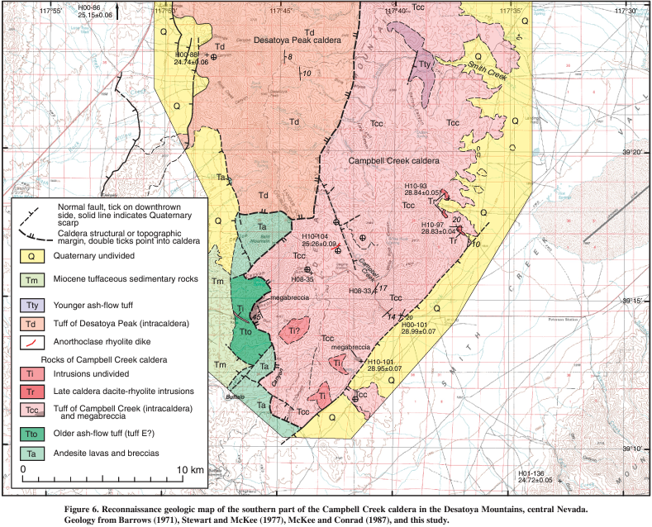
Caldera Source – Desatoya Mountains
Thick (up to 600m) Tcc deposits, megabreccia, and S, NW, and NW caldera walls
Eastern walls cut off by normal faulting and younger Desatoya Peak caldera
Campbell Creek Caldera estimated 600 km²
At least 35 km N-S and 14-20 km E-W
Volume of erupted tuff ~1200-3000km³ based on assumed collapse of 2-5 km, similar to other NV calderas
Explains wide distribution of tuff

